Slide 1


REDBUS DATA SCRAPING WITH SELENIUM & DYNAMIC FILTERING USING STREAMLIT
overview
Skills
Goal
conclusion

Slide 2
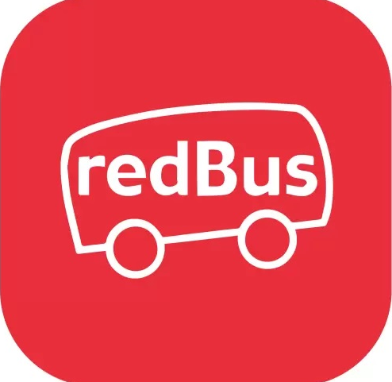
overview
Skills
Conclusion
GOAL
PROBLEM STATEMENT :
Difficulty In Finding Suitable Bus Routes And Fares
GOAL
Create A User – Friendly Application To Filter Bus Routes Based On Various Criteria

Slide 3
PROJECT OVERVIEW
This project involves building a web application that scrapes bus route data from the Redbus website using Selenium, stores the data in a MySQL database, and provides a dynamic filtering interface using Streamlit. The application allows users to select their preferred bus route based on criteria such as state, route name, bus type, fare range, and time.
conclusion
skills
overview
Goal

Slide 4
TECHNICAL STACK
Selenium
MySQL
Streamlit
pandas
overview
Conclusion
skills
Goal

Slide 5
CONCLUSION
provide interactive filtering capabilities. This allows users to easily find relevant information and makes it easier to maintain and update the app.
overview
conclusion
Skills
Goal

